Slide 1
Market Identifier

Slide 2
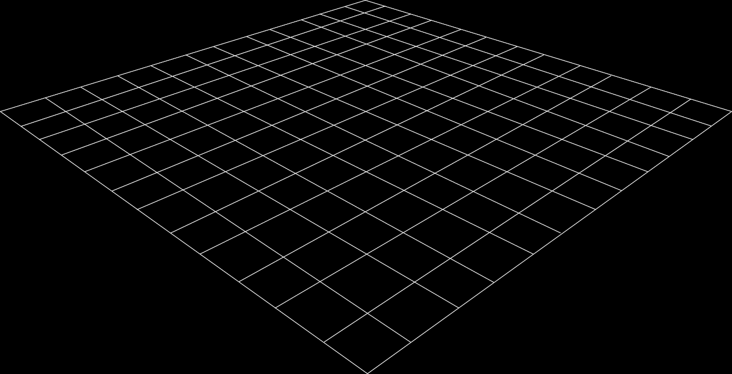
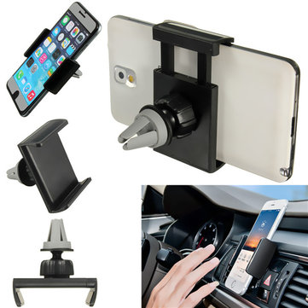
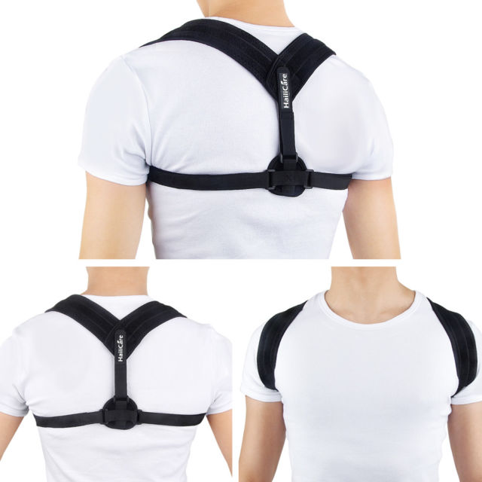
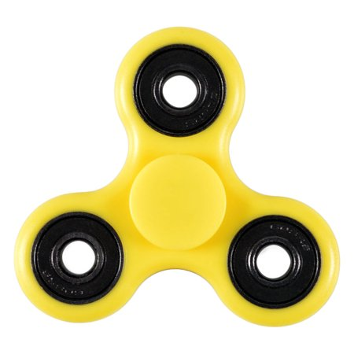
Let’s Follow Jim On A Journey
Product 1 May 2017
Product 2
July 2017
Product 3 September 2017
Everyone was buying one – trend/fad
Everyone needs one
Seemed to solve a big problem
Notes:
Fidget spinner. Everyone was buying the product (anecdotal evidence) – trend/fad – too much competition
Cell phone mount. Everyone needs it – monopoly - brand dominance
Back posture corrector. Solves a big problem. But ignored ratings – did not improve from competitors

Slide 3
Why Did Jim Fail?
Fidget Spinner
Market was too saturated
Price point was too low
Cell Phone Car Mount
Market was too saturated
No room for improvements
Back Posture Corrector
Market was too saturated
Customer needs were not addressed
Factors that should have been considered:
Review count
Too many positive reviews reflects a well established market – too competitive. People will buy from the listings with the highest # of positive reviews
Ratings
Too many listing with positive ratings also reflects a well established market with little opportunity to improve/innovate – the market is satisfied with existing solutions.
Number of sellers
Too many sellers = too competitive
Brand dominance
If one brand has a majority of the sales, the market shows monopoly like behavior, and will be difficult to penetrate
Price point
Hard to profit off a product with a price point below $10, especially for a startup
1
2
3
Notes:
4 different indicators.
Fidget spinner – Didn’t realize there were too many suppliers/listing with too many reviews
Cell phone mount – Didn’t realize a couple of the brands made most of the sales, and had way more reviews than everyone else
Back posture brace - Ignored the ratings, and didn’t improve the product

Slide 4

Problem:
Just like Jim, Over 90% of new e-commerce businesses fail within the 1st year.
Therefore, even though the technology era presents many new opportunities, especially for millennials, people are reluctant to become entrepreneurs.

Slide 5

Market Identifier
Motivation:
To help new entrepreneurs, with limited resources, discover profitable niche markets in a competitive, global economy

Slide 6




Team Members
Ayodele Jimoh
Computer Science
Kenny Kim
Computer Science
Ryan Ticlo
Computer Science
Rickesh Mistry
Business Informatics
Notes:
QUICK INTRO TO TEAM MEMBERS
Team Introduction
Ayo, Kenny, Ryan, and myself Rick

Slide 7

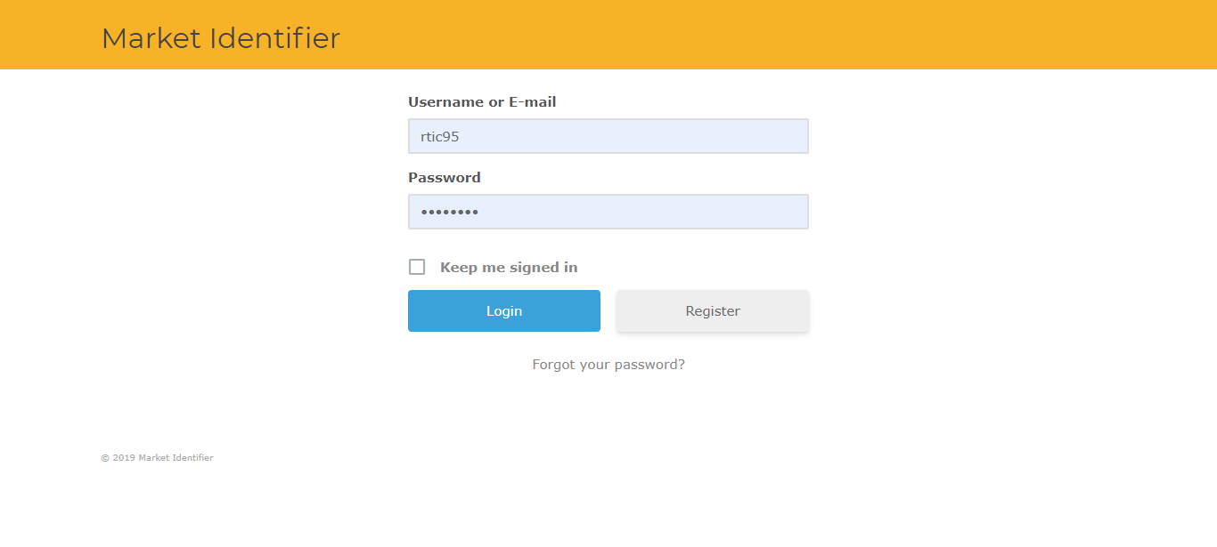
The Solution: Market Identifier
Created an application that analyzes sales, rating, brand dominance and review count to help gauge the success probability of a market.
Providing business analytics to small businesses and entrepreneurs which will reduce risk and uncertainty
Notes:
Our solution, Market Identifier is
an application that analyzes sales data from Amazon, Ebay, and Walmart.
We analyze key factors such as rating, brand dominance and review count to help gauge the success probability of a market.
This solution will provide
business analytics to small businesses and entrepreneurs to reduce risk and uncertainty when finding a new market to sell in

Slide 8
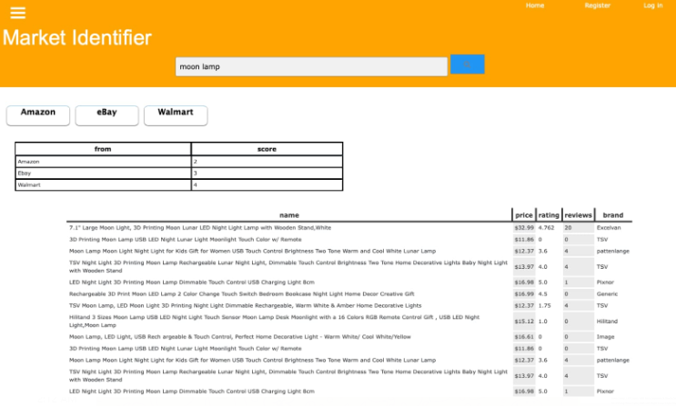
Jim Using Market Identifier
Before Market Identifier:
If he had used market identifier, he would have seen that fidget spinners are too competitive
After Market Identifier:
With Market Identifier he analyzed sales data and identified Moon Lamps are a profitable product.
No brand dominance,
High sales
Low reviews and ratings show room for improvement
Notes:
DO DEMO
Here is an example of how Jim would use Market Identifier
-Fidget spinner had 4/4
-MI score stuff
-MI Score is a value between 1 and 4 which is used to provide the user with an overview of how the market is based on the listings returned on the query
-MI Score is calculated by analyzing a combination of key success factors such as review count, rating, brand dominance, and price.
-A low score of 4 indicates that the market is not ideal. A high score of 1 indicates that the market is ideal according our solution and worth investigating more.
-Fidget Spinner had
-low price -> low profit
-lot of reviews -> Social Proof
-Brand dominance
-Eventually after more research he found Moon Lamps
-This market had good MI Score of 2
-Indicates that this market is worth investigating more
-By looking through his competitors information he found
-No brand held multiple listings -> no brand dominance
-High sales sometimes reaching thousands -> H Demand
-Low number of reviews but
-Ratings shows room for improvement
and possibility to become the lead seller in this market
Market Identifier helped Jim find that Moon Lamps was a good product to start selling

Slide 9
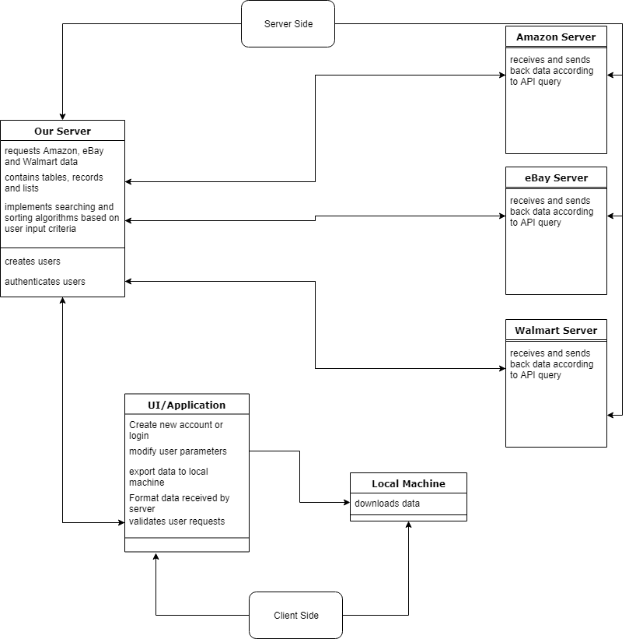
System Overview
Notes:
Here are some technical details..

Slide 10
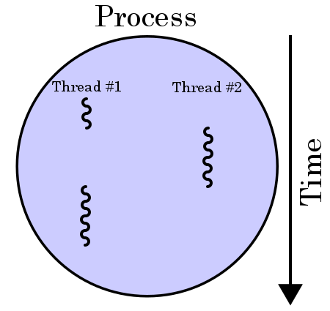
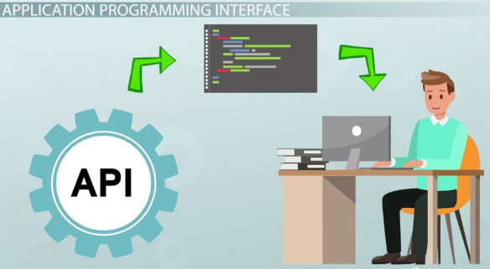
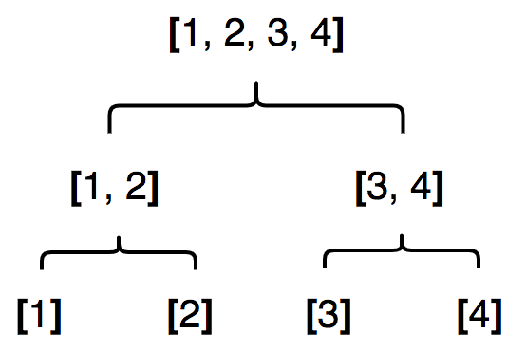
CS concepts implemented
1
Threading and Multi-processing 4C03, 3SD3
2
Binary Search and Quick Sort 2CO3, 3AC3
3
API 2XB3

Slide 11

Cost Analysis/Operations Research
1
Cost Analysis
API access - $99/month
AWS server cost - $12.99/month
Domain name cost - $10/year
2
As we scale we will save searches and data, rather than having to make new API calls for the same query
As the user base grows AWS cost will grow proportionally
Our algorithms will sort out bad products, and store them, so new API calls don’t need to be made
Stored in different tables
Notes:
How we store data, and the structures we use – how it will impact efficiency/cost in the future(if it scales)
Limitations – tokens, number of calls,
Scaling is easier with AWS

Slide 12
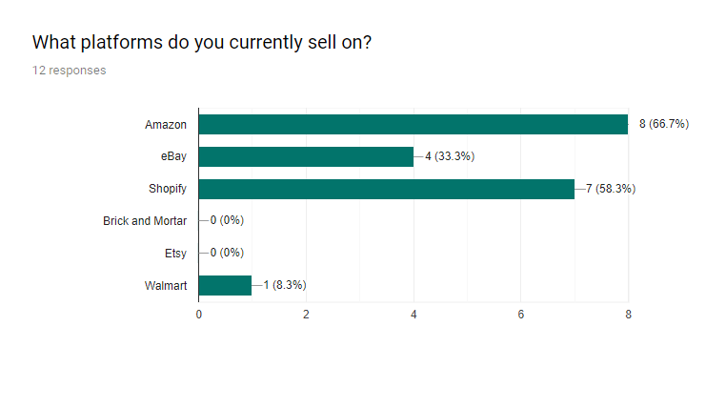
Survey

Slide 13
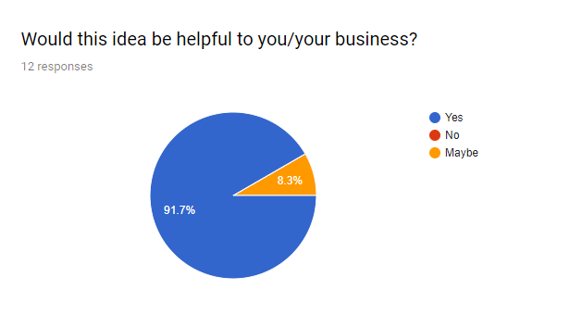
Survey

Slide 14
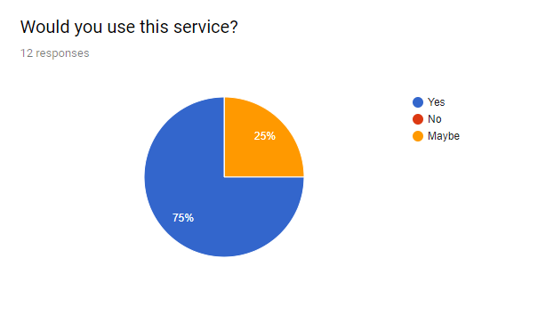
Survey

Slide 15
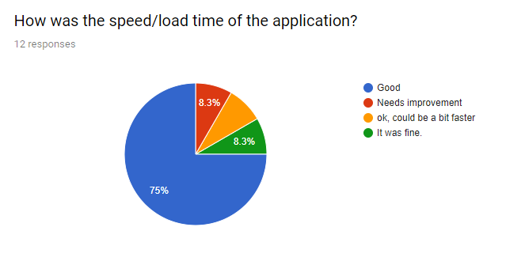
Survey

Slide 16
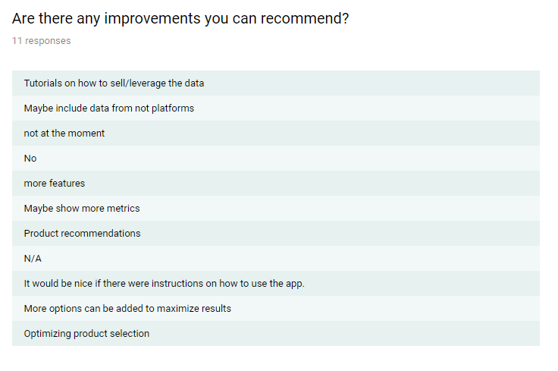
Survey

Slide 17
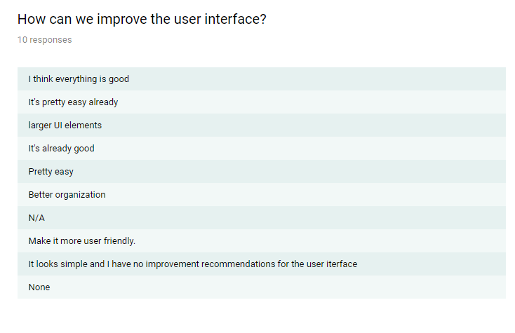
Survey

Slide 18
Competitors
Competitors provide similar solutions however they only focus on data on one e-commerce platform
Our solution differentiates itself by providing
Sales data for Amazon, Ebay, and Walmart
The MI Score which allows users to quickly see if a market is bad

Slide 19
Conclusion
This application can help many entrepreneurs achieve financial success and stimulate the economy.
Special thank you to Dr.Archer and Dr.Anand
Questions
Notes:
Thank every and give special thanks to supervisors
Open up for questions

